Slide 2
Unit Objectives
Plan a website
Create a folder for website management
Set up a website
Add a folder to a website
Save a web page
Copy a new image to a website
Add new pages to a website

Slide 3
Planning a Website
Research site goals and needs
Create a wireframe
Create folders
Collect the page content and create the web pages
Test and modify the pages
Publish the site

Slide 4
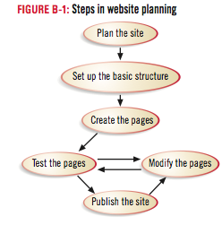
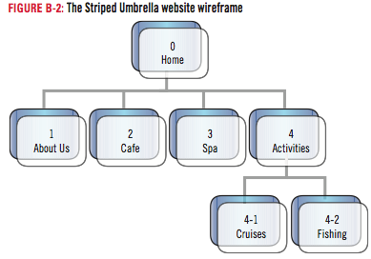
Planning a Website

Slide 5
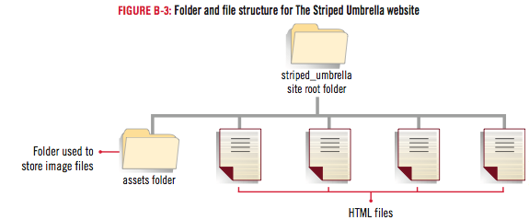
Planning a Website

Slide 6
Design Matters
IP addresses and domain names
A website is identified by a permanent IP address
Example: 192.150.18.200
A domain name is used as an easier way of referring to a website
Example: www.adobe.com

Slide 7
Creating a Folder for Website Management
Start Dreamweaver
Click the Files panel tab or expand the Files panel, if necessary, to view contents
Click the Files panel Site list arrow
Click to select the drive, folder, or subfolder in the list where you want your local site root folder to reside
Right-click (Win) or control-click (Mac) the drive, folder, or subfolder that you selected in Step 4, then click New Folder
Type striped_umbrella, then press [Enter] (Win) or [return] (Mac)

Slide 8
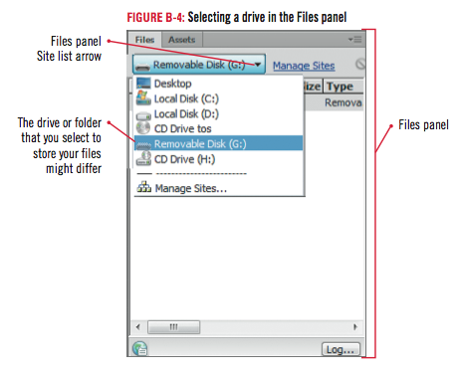
Creating a Folder for Website Management

Slide 9
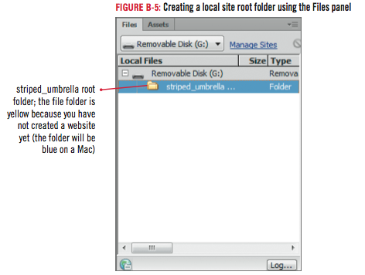
Creating a Folder for Website Management

Slide 10
Design Matters
Managing files
Good file management is extremely important
No uppercase letters or spaces in filenames

Slide 11
Setting Up a Website
Click Site on Application bar (Win) or Menu bar (Mac), click New Site
Type The Striped Umbrella in the Site Name text box
Click the Browse for folder button, click the Select list arrow (Win) or Current file location list arrow (Mac) in the Choose Root Folder dialog box, navigate to the drive and folder where you created your Local Site Folder double-click (Win) or click (Mac) the striped_umbrella folder, then click Select (Win) or Choose (Mac)
Click Save in the Site Setup dialog box

Slide 12
Setting Up a Website

Slide 13
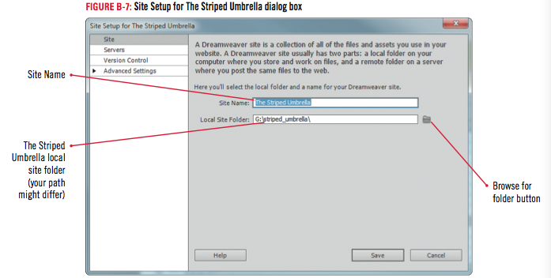
Setting Up a Website

Slide 14
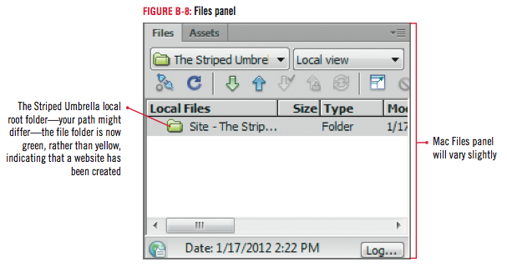
Setting Up a Website

Slide 15
Adding a Folder to a Website
If necessary, click the Files panel tab to expand the Files panel, then click the striped_umbrella folder in the Files panel if necessary
Click the Panel menu button on the Files panel, then point to File
Click New Folder
Type assets in the folder text box, then press [Enter] (Win) or [return] (Mac)
Click Site on the Menu bar, click Manage Sites, then click Edit the currently selected site button

Slide 16
Adding a Folder to a Website
Click Advanced Settings from the category list, click the Browse for folder icon
Click Select list arrow (Win) or Current file location list arrow (Mac) if necessary to display the striped_umbrella folder in the Select text box
Click the assets folder
Click Select (Win) or Choose (Mac), click Save in the Site Setup for The Striped Umbrella dialog box, then click Done in the Manage Sites dialog box

Slide 17
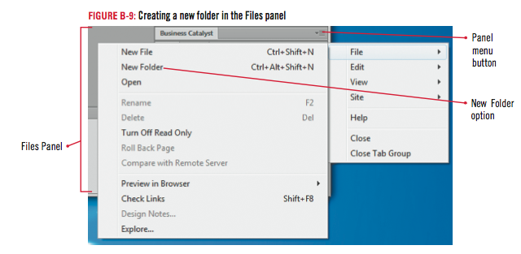
Adding a Folder to a Website

Slide 18
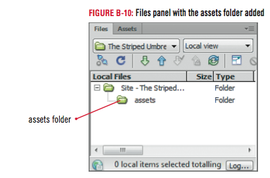
Adding a Folder to a Website

Slide 19
Clues to Use
Using the Files panel for file management
Use the Files panel to add, delete, move, or rename files and folders
Do not use Windows Explorer (Win) or Finder (Mac)
If site root folder is copied or moved to a new location:
Define site again in Dreamweaver

Slide 20
Saving a Web Page
Click File on the Menu bar, click Open, navigate to the drive and folder where you store your Unit B Data files, then double-click dwb_1.html
Click File on the Menu bar
Click Save As
Click the Save in list arrow (Win) or the Current file location list arrow (Mac) to navigate to the striped_umbrella root folder
Then double-click (Win) or click (Mac) the striped_umbrella folder

Slide 21
Saving a Web Page
Click in the File name text box (Win) or Save As text box (Mac) if necessary, select the existing file name (dwb_1.html)
- Type index.html, click Save, click No in the Update Links dialog box, maximize the document window if necessary, then click the Show Design view button
Click the Close button on the dwb_1.html file tab, click the Insert panel drop-down menu, then click Color Icons if necessary to show the icons in color

Slide 22
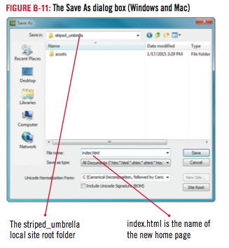
Saving a Web Page

Slide 23
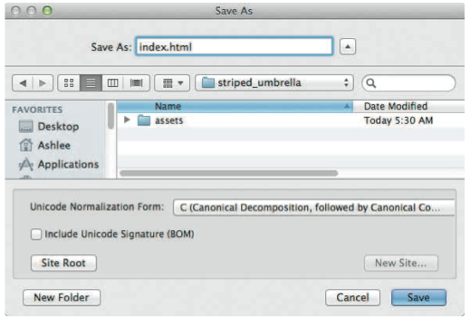
Saving a Web Page

Slide 24
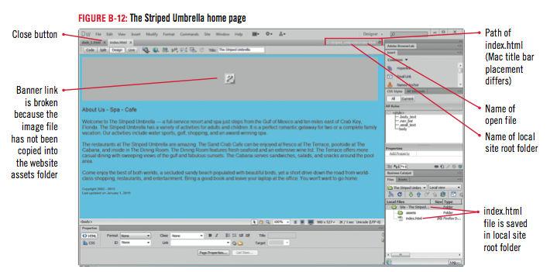
Saving a Web Page

Slide 25
Copying a New Image to a Website
Click the gray box representing the broken image on the index page
Double-click the right side of the Property inspector to expand it if necessary
Click the Browse for File button, click the Look in list arrow (Win) or the Current file location list arrow (Mac) to navigate to your selected drive and folder
Double-click the unit_b folder, double-click the assets folder, then double-click the su_banner.gif file
Click anywhere on the page outside of the banner, if necessary, to display the image, select the image again to display the image settings in the Property inspector, click File on the Menu bar, click Save

Slide 26
Design Matters
Making a good first impression
Use pleasing colors and images
Use friendly and easy-to-understand text
Use a simple navigation
Have others evaluate your website before finalizing it

Slide 27
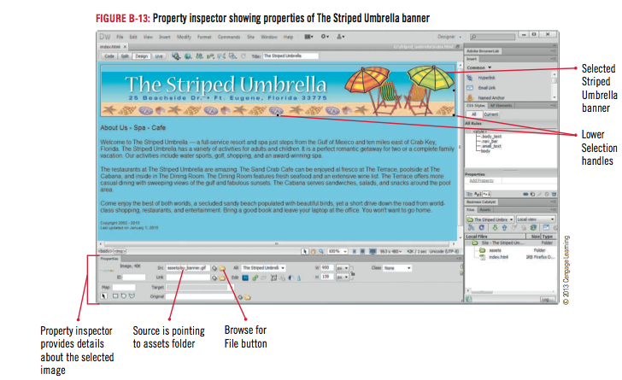
Copying a New Image to a Website

Slide 28
Design Matters
Planning the page layout
Templates are web pages that contain the basic layout for each page of a site

Slide 29
Adding New Pages to a Website
Click the Refresh button on the Files Panel
Click the plus sign (Win) or the triangle (Mac) to the left of the assets folder in the Files panel if necessary
Click the site folder under the Local Files column to select it
Right-click the site folder, click New File, click in the filename text box to select untitled if necessary, type about_us, then press [Enter] (Win) or [return] (Mac)

Slide 30
Adding New Pages to a Website
Repeat Step 2 to add five more blank pages to The Striped Umbrella Website
Name the new files spa.html, cafe.html, activities.html, cruises.html, and fishing.html
Click the Refresh button on the Files panel toolbar
Click File on the Menu bar, click Close, click File on the Application bar, then click Exit (Win) or click Dreamweaver on the Menu bar, then click Quit Dreamweaver (Mac)

Slide 31
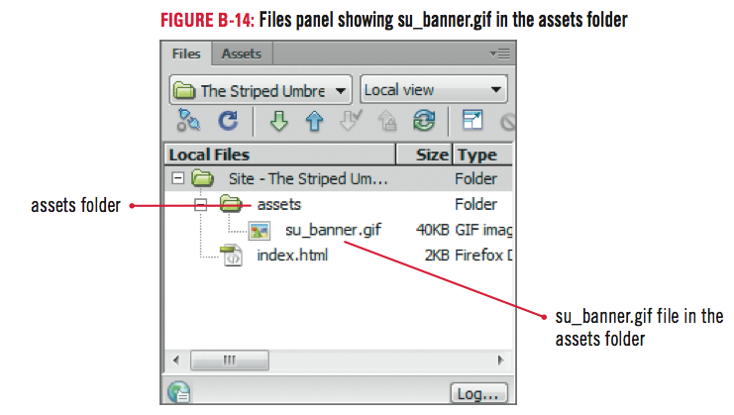
Adding New Pages to a Website

Slide 32
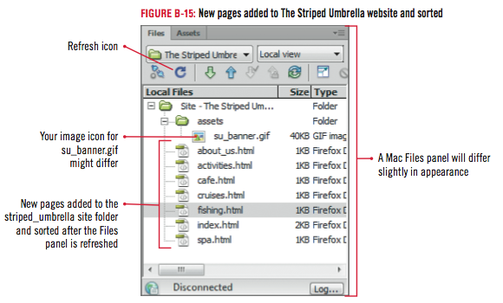
Adding New Pages to a Website

Slide 33
Unit Summary
Plan a website
Create a folder for website management
Set up a website
Add a folder to a website
Save a web page
Copy a new image to a website
Add new pages to a website

